Slide 1




Social Impact Assessment Report
Detailed analysis of the Menstrual Hygiene Education Sessions
organized by -
District Administration Rupnagar
District Program Office Rupnagar
District Development Fellowship
The Crimson Project

Slide 2
About the Initiative
We, Project Crimson, aim to eliminate the stereotypes associated with Menstruation by educating and empowering communities to speak up and strive to make menstrual products affordable for all.
Till date, a large section of the society perceives menstruation to be impure. Women feel ashamed to talk about periods and avoid discussing the topic. Therefore, young girls are not well- informed of the crucial aspects related to menstruation, which they ought to know. Since, no light is ever shed on the topic of menstruation in the households and the schools, young boys also don’t understand the immense importance of menstruation in a woman's life.
Thus to tackle this, on the occasion of Menstrual Hygiene Day, Enactus SVC in collaboration with the Government of Rupnagar, organized a Menstrual Education Programme for the students of classes 6th to 12th under the Beti Bachao Beti Padhao Scheme from 28th May to 10th June 2021.

Slide 3
Till date, we have conducted a total of 36 sessions and have sensitized 5500+ girls and 1000+ boys.
The objectives of our sessions are as follows:-
Education of adolescents on the topics related to menstrual health and hygiene by the end of which the children shall be better acquainted with the process
They shall also be aware of the choices available to them regarding their sexual and reproductive health
This would help them with relatable questions and stories which can be shared back and forth to establish an environment of ease and comfort.
Ensure that the students are given a safe space to talk, discuss and learn about menstruation, and that there is easy access to necessities such as pads.
Break the mental block of menstruation being a “girl problem” and normalizing an open dialogue amongst boys as well.

Slide 4
About the Sessions
The sessions began with the inauguration by the respected Ms. Sonali Giri, IAS Deputy Commissioner and were concluded by the respected Ms. Deepshikha Sharma, IAS Additional Deputy Commissioner.
The sessions took place in a well organised and structured manner. There were 4 sessions each day, two for the girls and two for the boys. The duration of each session was about 60 minutes and was broken down into the following phases:
Ice breaking session
The speaker session supported with an informative PPT
The question & answer round
The sessions commenced with classes 6 & 7 with a strength of around 50 students in every session. As we proceeded towards higher classes, the strength of the attendees reached a perfect 100 in each session.
We take immense pride in reporting that, under these sessions, we have covered 200+ schools and impacted the lives of 3000+ students.

Slide 5
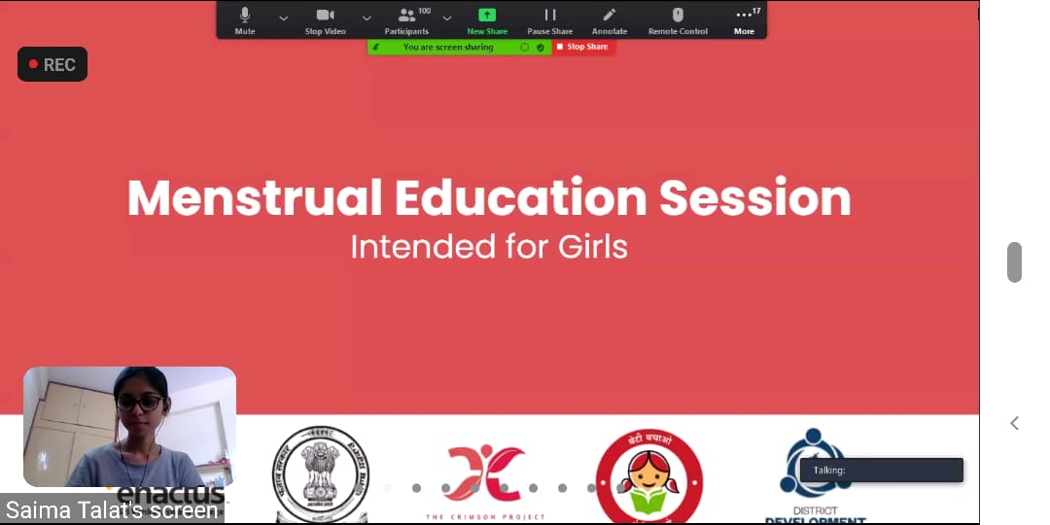
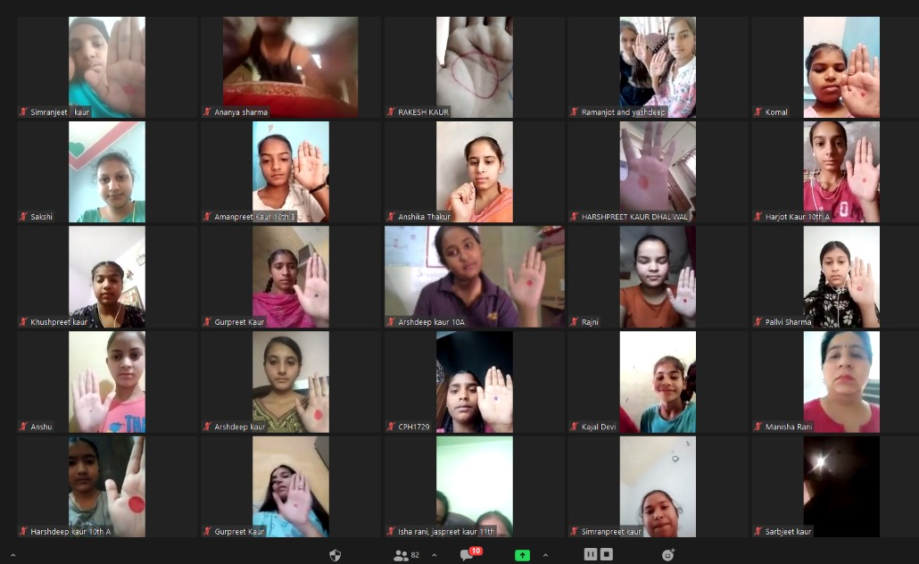
Virtual Awareness Sessions

Slide 6
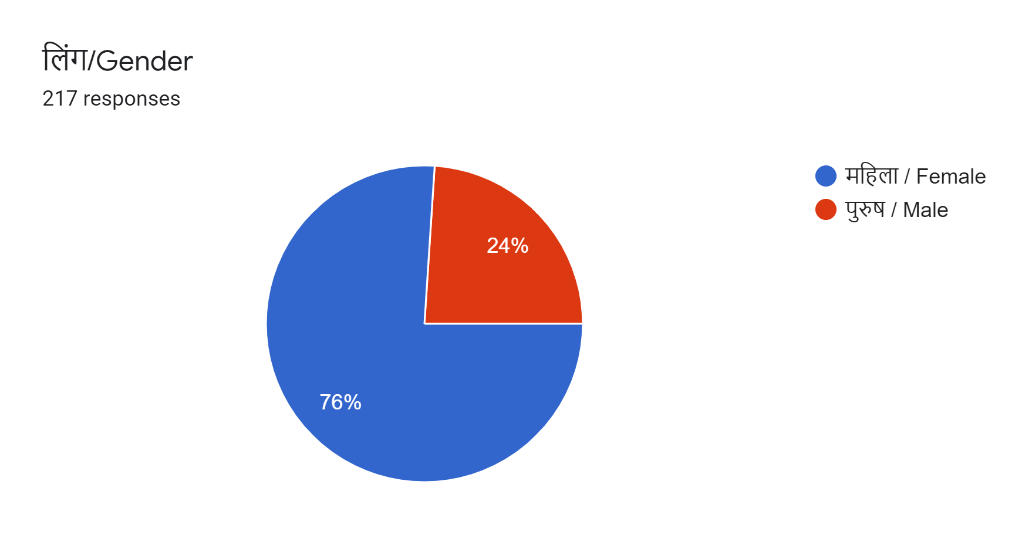
Composition of Attendees

Slide 7
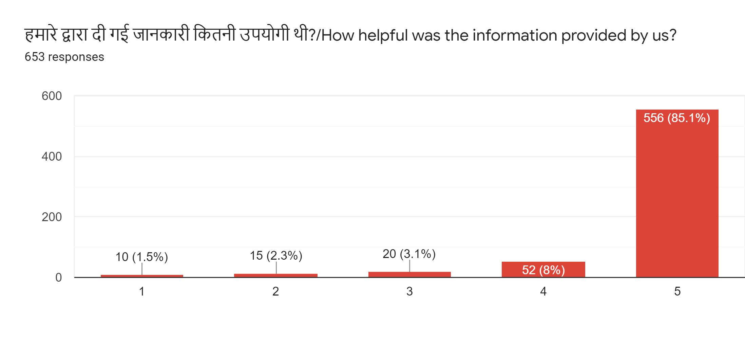
Feedback for the Session

Slide 8
Description of the Sessions
Girls’ Sessions
The session commenced with ice breaker rounds where some simple games were played which allowed the participants to be interactive throughout the session. The script drafted for the girls was very impactful and covered extremely crucial topics relating to menstrual awareness. The entire menstrual process, puberty and bodily changes, premenstrual syndrome, proper use and disposal of pads, period tracking, PCOS, nutritional intake and importance of exercise were discussed in great detail. The girls were also made aware about certain myths and taboos related to the topic. After the speaker session, the question & answer round began. The girls of classes 6-7 were a little hesitant in asking questions, so the speakers ensured that they were comfortable. However, the girls of classes 10-12 were very interactive and asked several questions related to periods, the pain and discomfort involved in it and the usage of pads.

Slide 9
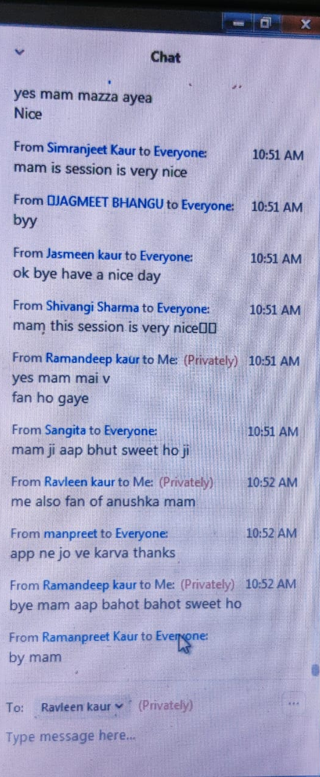
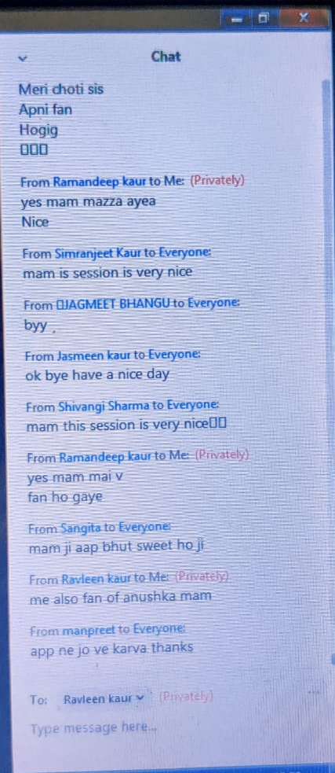
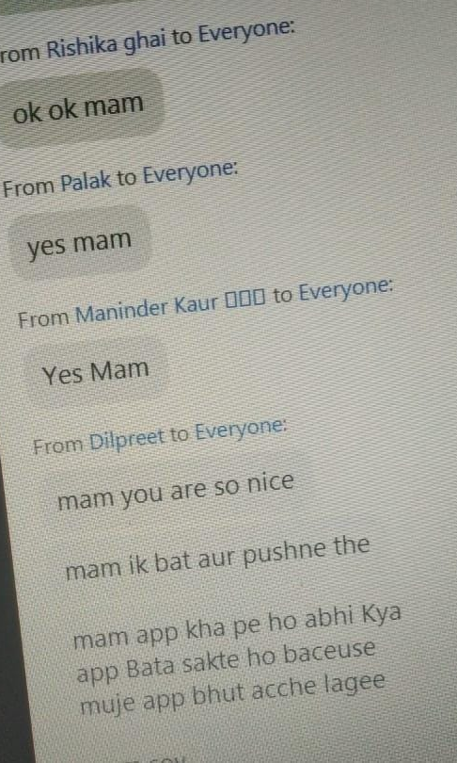
Interaction in the Sessions

Slide 10
Boys’ Sessions
The boys’ sessions kicked off in the same way as the girls’. They were interactive during the ice breaker rounds. The boys’ were asked if they had ever heard about menstruation and the topic was introduced to them slowly. The process of menstruation was told to them in a story based format to make them understand the concept better. The speaker discussed menstruation and the taboos and myths related to the topic. The boys were made to understand that the process was just as normal as any other process of the body. Myths and taboos were discussed in detail in the boys’ sessions. The boys’ were made aware of their responsibilities towards girls and women during the time of their menstruation. The question & answer began after the speaker completed.

Slide 11
Topics Covered
By the end of the session, the various topics of information with which girls were familiarised included ;
Menstrual hygiene management
Basics of menstrual cycle
Puberty and bodily changes
Premenstrual Syndrome
Period tracking
Nutritional intake
Breaking myths and taboos related to the topic
The analysis of menstrual products available in the market
Choices available to the menstruators regarding their sexual and reproductive health
Various health disorders

Slide 12
By the end of the session, the various topics of information with which boys were familiarised included ;
The process of menstruation
The myths and facts
Ways to help their mothers/sisters/friends in these times thereby making them more sensitive to the needs of others along with being a responsible citizen.

Slide 13
Analysis of the Question & Answer Round
Certain questions that were asked frequently during the sessions were -
Where do periods occur and why does it hurt during menstruation?
Why doesn’t period happen to boys?
Why use a sanitary pad?
How frequently do periods occur?
How to identify if we have irregular periods and what steps are to be taken to regularise periods?
What is PCOS?
The misconceptions and taboos related to the topic like restriction on entering the place of worship, eating pickles and curd and avoiding exercise.
What should be eaten during periods to stay healthy and how to maintain a balanced diet?
Whether to exercise or not during menstruation?

Slide 14
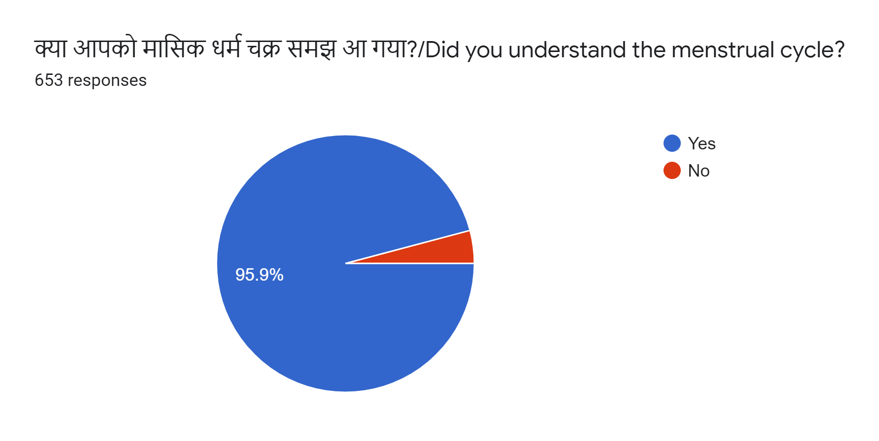
Statistical Analysis of the Sessions

Slide 15
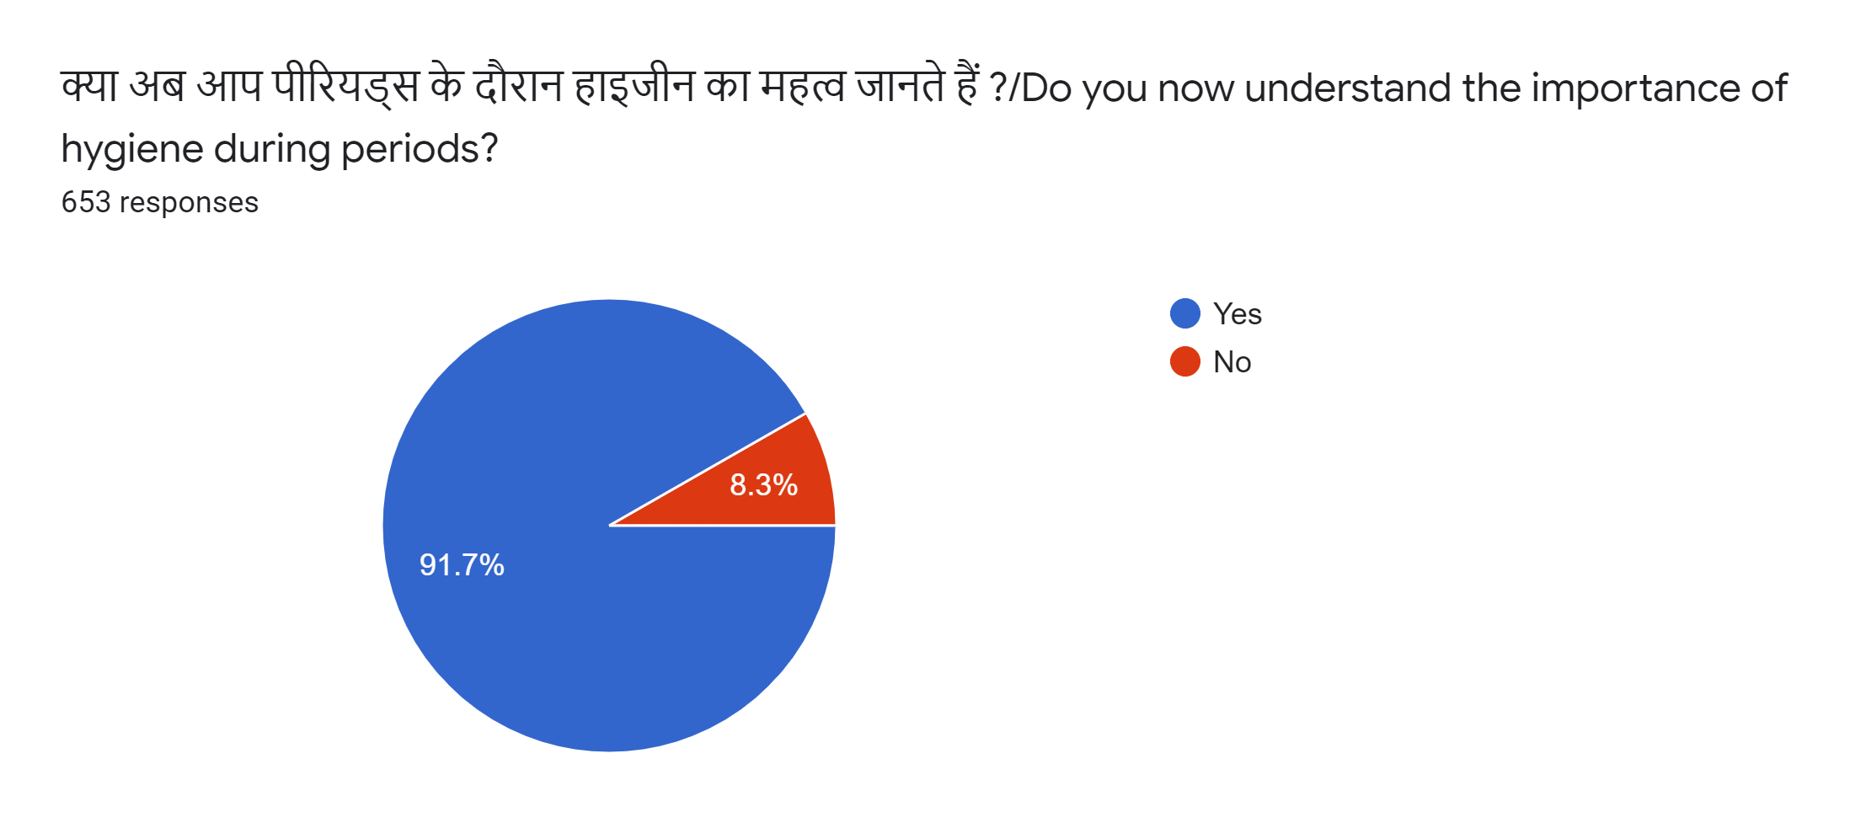

Slide 16
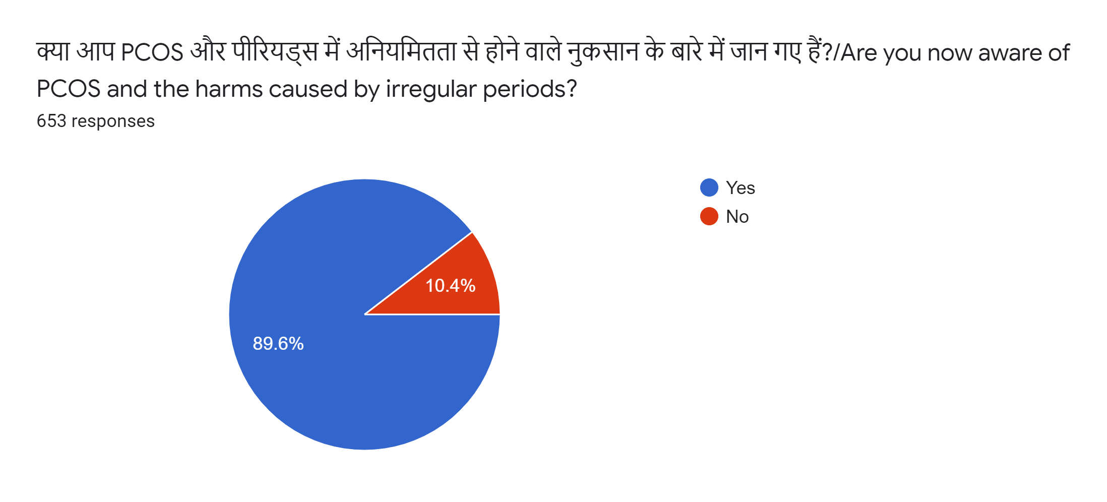

Slide 17
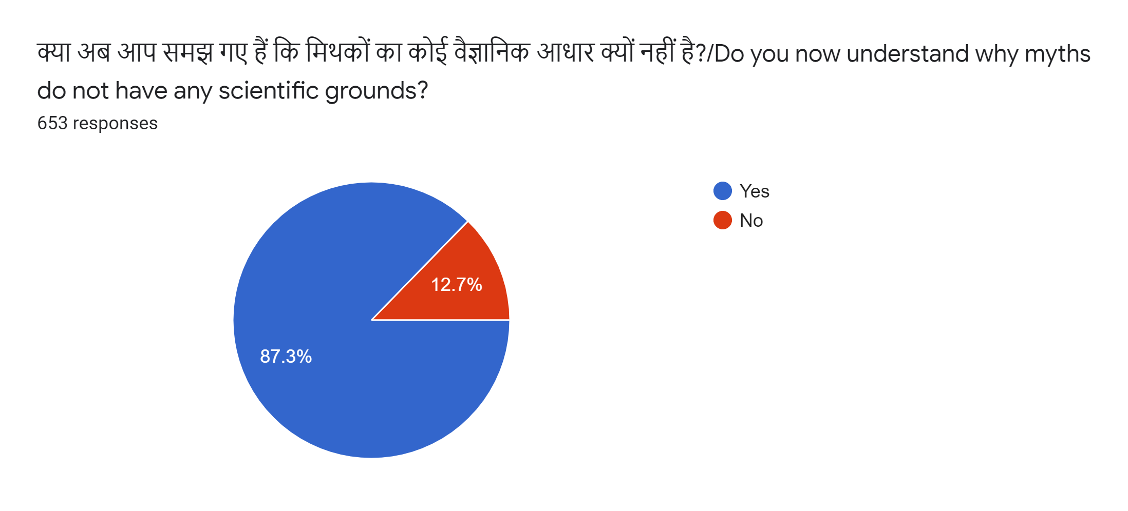

Slide 18
Problems Faced
Technical issues - There were students who faced technical issues and were not able to join or their connection was unstable. To tackle this, as an alternative, educational Youtube videos have been prepared for those to view who couldn’t attend the session properly.
Constraints faced due to online mode - Due to the sessions being online, a personal level connection was not formed. To bridge the communication gap effectively the speakers used common examples to make the learning easier with the support of visuals shown through an elaborative PPT.
Questions specific to medical conditions - The students were inquisitive and asked certain questions that the speakers were not equipped to answer as it required medical expertise. However, the speakers clearly advised the students to discuss it with their parents and further consult a doctor to attain more detailed knowledge.

Slide 19
Recommendations
The general feedback that we've collected from the speakers and the students through the mode of feedback forms floated at the end of each session, suggests that there's lack of knowledge about various important topics like Menstruation, Sex Education, Gender Based Discrimination, etc., within the education structure. To work on the same, we offer to provide the following recommendations:
Future sessions with gynecologist- As the students were very curious to know about the specific medical details mentioned in the sessions, the presence of a specialist like a gynecologist along with the speakers would make the session even more comprehensive towards educating communities.
Offline sessions - Although the team came up with a detailed and interactive approach to make students learn about menstruation online, offline sessions would allow for a better understanding for the students
Visual Content: While conducting the sessions we have also noticed that students respond well to visual content and this is a way administration can use to introduce other new topics to the students.
More sessions for boys: The boys had no questions during the sessions and it was evident that they were feeling awkward or shy. The interaction was also quite low in the boys’ session and so we would recommend more such sessions for them

Slide 20
Conclusion
We would like to extend our gratitude to the District Administration, Rupnagar for their invaluable support throughout the programme. Project Crimson would like to extend this collaboration in the future and organise follow-up offline sessions with the students in Ropar.
When it comes to menstruation and the taboos around it, we did encourage teachers to create an atmosphere of open dialogue and hope that administration can facilitate this process as well.
This would not only help the students to carry a positive mindset back to their homes but also allow them to recognise discriminatory practices around themselves and put an end to them.

